Slide 1
Training physical model controllers using sampling-based optimization
Tarun Yenamandra
Saarland University
Mentor: Erik herrmann

Slide 2
So Far..
Data-driven synthesis based on motion graphs
Data-driven synthesis based on motion fields
Interactive data-driven synthesis based on FCNs
Motion synthesis based on generative neural networks

Slide 3
Today: Training Physical model controllers
Using capture data and given a model of the skeleton, learn controllers that generate these motions and change between these motions.
Does not use capture clips to generate output clips
Uses the capture data as training samples

Slide 4
Introduction: Guided Learning of Control Graphs for Physics-based Characters
Learning:
Input: Capture data during training
Process:
Create Motion Graph
Convert the Motion Graph to a Control Graph
Sample random walk on the Control Graph and learn the controllers for characters using this data
Output: Control Graph
Real-Time:
Input: Motion control handle
Process:
Transitions in the control graph based on the desired motion
Output: synthesized motion for characters

Slide 5
Organization
Rigid Body Physics Based Simulation
Control Fragments
Controllers
Building Control Graphs from Motion Graphs
Guided sampling-based controller
Results
Conclusion and Discussion

Slide 6
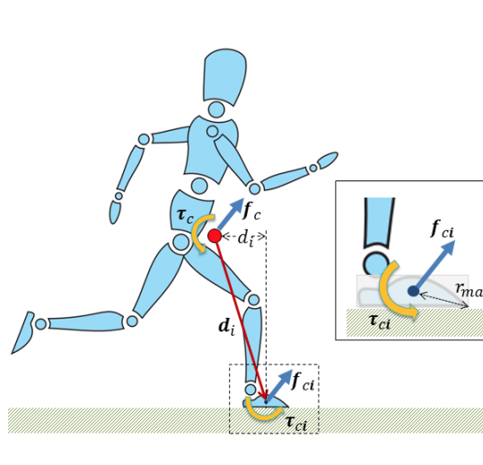
Rigid body physics-based simulation
Each body is represented as a state vector containing different parameters such as position, orientation, linear and angular velocity
A physics-based simulator updates the state vector every time step by applying different forces acting on the body such as gravitation and inertia
Mass of the body is also considered for simulating the motion
A physics-based simulator also takes care of collision between bodies by adding addition constraints on position, velocity, center of gravity of the body, and inertia matrix of the body
Source: Libin Liu et al, 2016
Slide Credits: Erik Herrmann

Slide 7
Rigid body physics-based simulation
Each body is represented as a state vector containing different parameters such as position, orientation, linear and angular velocity
A physics-based simulator updates the state vector every time step by applying different forces acting on the body such as gravitation and inertia
Mass of the body is also considered for simulating the motion
A physics-based simulator also takes care of collision between bodies by adding addition constraints on position, velocity, center of gravity of the body, and inertia matrix of the body
Source: Sclance.com
Slide Credits: Erik Herrmann

Slide 8
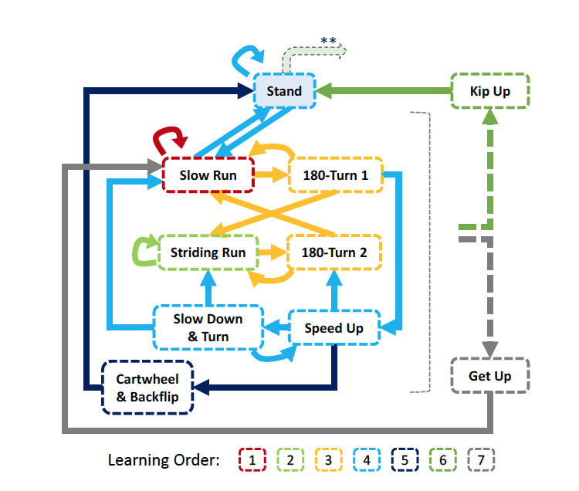
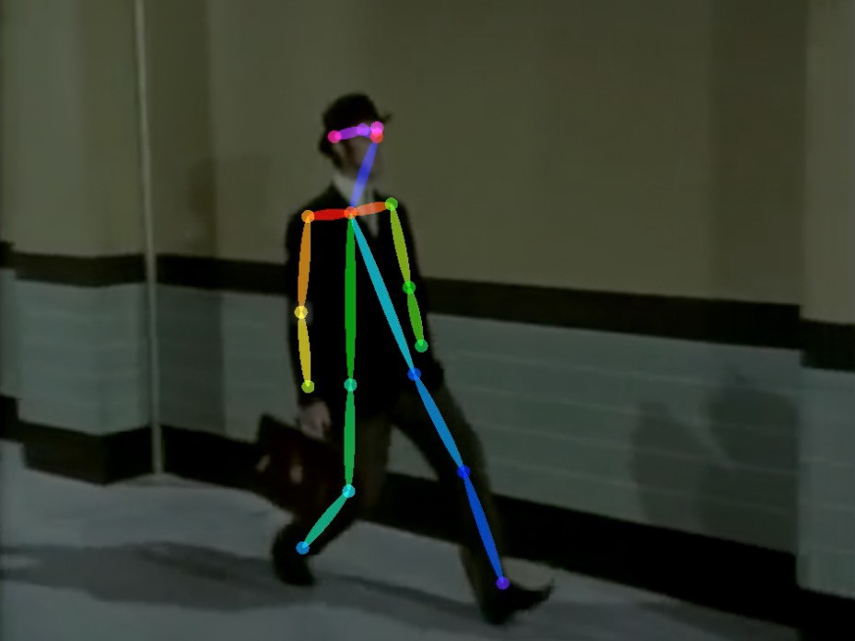
Control Graphs
A control graph consists of controllers which produce the actions of the characters in the motion clips
It is like a motion graph but instead of video clips there are PD controllers learned to create the motion in the clips
Source: Human Pose Detection on Medium by Sameem
Source: Liu et al, 2016

Slide 9
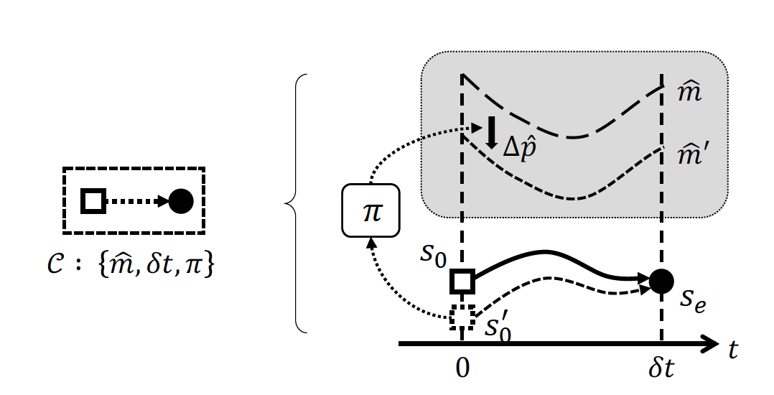
Control Fragment
Control fragment ($𝒞:\{\hat{m},δt,π\}$) is a tuple {sequence of target poses, time from start to end state, feedback}
$π$ provides the feedback to match the target poses $\hat{m}$
Source: Liu et al, 2016

Slide 10
Control fragments - Why is feedback needed?
The actual starting state for a control fragment ($s_{0}^{′}$) does not exactly match with the expected starting state ($s_{0}$).
Therefore, feedback $π$ is needed to track the new poses (${\hat{m}}^{′}$) instead of actual poses ($\hat{m}$)
${\hat{m}}^{′}=Δ\hat{p}⊕\hat{m}$, for some offset $Δ\hat{p}$
$⊕$ is quartenion multiplication between corresponding joint rotations (basically add an offset to the rotation angle at each joint)
Source: Liu et al, 2016

Slide 11
Control fragments - WHAT is THE feedback?
$a=π\left(s;M, \hat{a}\right)=Ms+\hat{a}$
a – feedback action – 11 DoF of waist, hip, and knees(1)
$\hat{a}$ - is an affine term
M – feedback gain matrix
s – simulation state
$s=\left(q_{0}^{∗}, h_{0},c, \dot{c}, d_{l}, d_{r}, L\right)$
S = (root orientation, root height, centroid, centroid velocity, vectors from centroid to left foot, to the right foot, angular momentum)
18 – DoF
$Δ\hat{p}$is then computed from feedback action using forward kinematics
Source: Liu et al, 2016

Slide 12
CONTROLLER
A controller is simply a cascade of control fragments.
In a Control Graph, each control fragment can have multiple incoming or outgoing edges based on the Control Graph requirements
Source: Liu et al, 2016

Slide 13
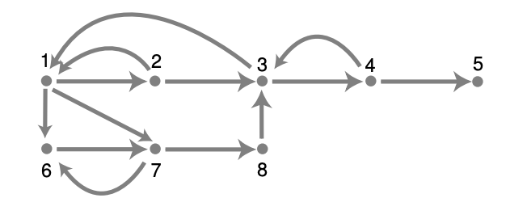
Recall motion Graphs
Each node has a motion clip corresponding to a “steady state” motion.
Each edge is a transition from one action to another.
Source: Kover et al, 2002

Slide 14
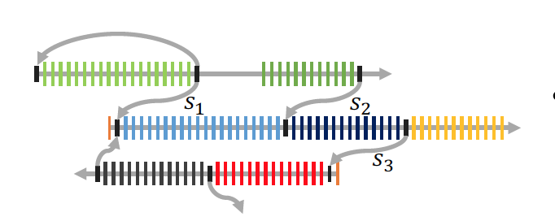
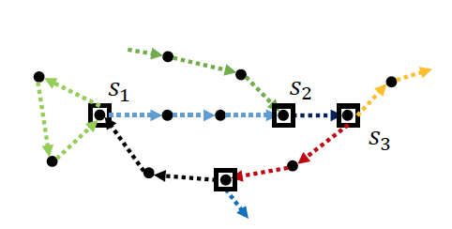
CONTROL GRAPH
Build a reference motion graph from the input clips.
Fixed during the learning process
The improved SAMCON algorithm (as well as some noise reduction and time scaling techniques) is used to construct high quality open-loop control trajectories from the motion clips.
The feedback policies $π$ are all initialized to 0.
Motion Graph. Source: Liu et al, 2016
Control Graph. Source: Liu et al, 2016

Slide 15
Learning the Feedback policies
Feedback policies are learned by sampling a random walk and generating controllers for these random walks.
Random walk in the context of control graph is generating motions with random transitions
A graph random walk W consists of multiple control fragments each of which is visited multiple times
The guided learning algorithm uses linear regression to learn the most suitable action for each control fragment, given the samples from W
a in (s,a) state-action pairs is learned.

Slide 16
Guided learning as em-based policy search
Policy learning is interpreted as expectation maximization. The goal is to maximize the expected return $J\left(θ\right)= \int_{τ}{P\left(τ;θ\right)R(τ)}$
$P\left(τ;θ\right)=P\left(s_{k}\right|s_{k−1}, a_{k})π_{k}\left(a_{k}\right|s_{k−1};θ) P(s_{k−1})$
= transition density * feedback density * density of the previous state
$τ$is the tuple $(s_{k}, s_{k−1}, a_{k})$
$P\left(τ;θ\right)$ is the probability distribution of the simulation tuple.
$P\left(s_{k}\right|s_{k−1}, a_{k})$ is the transition probability.
$π_{k}\left(a_{k}\right|s_{k−1};θ)$ is the feedback distribution. This is modelled as a gaussian distribution.
$π_{k}\left(a_{k} | s_{k−1};θ\right)=𝒩(M_{k}s_{k−1}+{\hat{a}}_{k},\sum_{k}{)}$
$R(τ)$ is a special reward function

Slide 17
Guided learning as em-based policy search -2
Maximizing $L\left(θ;θ_{0}\right)= \int_{τ}{P\left(τ;θ_{0}\right)R\left(τ\right) log π(a_{k}|s_{k−1};θ)}$ maximizes the expectation
Empirically: $L\left(θ;θ_{0}\right)≈ \frac{1}{N_{k}} \sum_{i=1}^{N_{k}}{R\left(τ^{i}\right)log⁡{ π}_{k}(a_{k}^{i}|s_{k−1}^{i};θ)}$
Maximizing L with tuple samples, $τ_{k}^{i}$, for each control fragment $\{𝒞_{k}\}$ in a successful long random walk gives us the optimal feedback policies as a result of maximizing the expectation of reward
$R(τ)$ is a special reward function
= 1 if $τ$ is good enough in the long run so that random walk can succeed.
= 0 otherwise

Slide 18
Guided learning as em-based policy search - 3
Using regularized Linear Regression we get:
$M_{k}={\left[(S_{k}^{T}S_{k}+λI\right)}^{−1}(S_{k}^{T}A_{k})]^{T}$
$λ$ ($={10}^{−6}$) is the regularization parameter, $M_{k}$ is the feedback gain matrix for a control control fragment $\{𝒞_{k}\}$
$S_{k}={\left[s_{k−1}^{1}−{\overline{s}}_{k−1},s_{k−1}^{2}−{\overline{s}}_{k−1}, …,s_{k−1}^{N_{k}}−{\overline{s}}_{k−1}\right]}^{T}$
$A_{k}={\left[a_{k}^{1}−{\overline{a}}_{k},a_{k}^{2}−{\overline{a}}_{k}, …,a_{k}^{N_{k}}−{\overline{a}}_{k}\right]}^{T}$
${\overline{s}}_{k−1}$ and ${\overline{a}}_{k}$are averages of $s_{k−1}^{i}$ and $a_{k}^{i}$
Random walk is long enough so that $N_{K}≥200$for all control fragments.
${\hat{a}}_{k}={\overline{a}}_{k}−M_{k}{\overline{s}}_{k−1}$
${diag(Σ}_{k})={\frac{1}{N_{K}}[\left({A_{k}− S}_{k}M_{k}^{T}\right)}^{T}({A_{k}− S}_{k}M_{k}^{T})]$ are the observed prediction variances to provide stochastic version of control policies.
Finally, the feedback policy is $π_{k}\left(a_{k} | s_{k−1};θ\right)=𝒩(M_{k}s_{k−1}+{\hat{a}}_{k},\sum_{k}{)}$

Slide 19
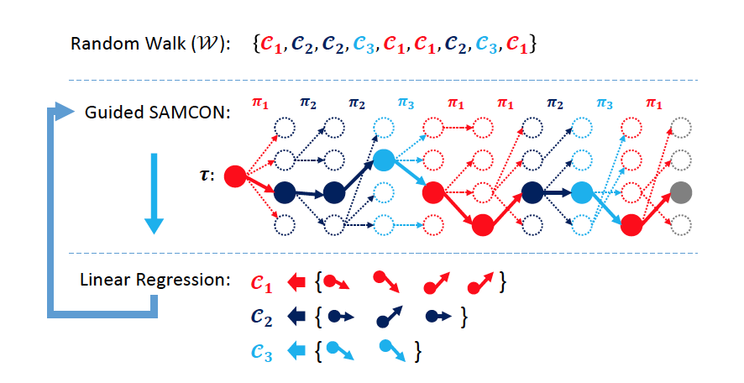
Learning the Feedback policies
Learn the control policy, which provides. a = f(s) where, f is linear and sampled from a normal distribution.
Control Oracle or the GUIDE:
$π_{k}\left(a_{k} | s_{k−1};θ\right)=𝒩(M_{k}s_{k−1}+{\hat{a}}_{k},\sum_{k}{)}$
$∑_{k}$ captures the variances in the action policies learned from the samples of random walk
But how are the tuples, $τ$, generated and how are the parameters learned over iterations, i?
Sampling Based Controller: Guided SAMCON.
Source: Liu et al, 2016

Slide 20
Guided sampling-based controller (SAMCON)
Only learns from samples which complete the random walk ‘successfully’ in every iteration
A walk is successful when the algorithm successfully finds controls for the random walks from the control graph
SAMCON:
Formally, a random walk $𝒲=\left\{𝒞_{1},𝒞_{2}, …, 𝒞_{N}\right\}$ (unordered control fragments).
$N=\sum_{k=1}^{K}{N_{k}}$, $N_{k}$ is the number of times each control fragment k appears in the random walk
Start with $𝒞_{1}$ and develop sequence of actions $\{a_{k}\}$ that result in the states $\{s_{k}\}$ that are close to desired reference motions
The tuples $\left\{\left(s_{k}, s_{k−1}, a_{k}\right)\right\}$ are thus generated. $s_{k−1}$ is just the previous state to the {$s_{k}$} in $𝒲$
Source: Liu et al, 2016

Slide 21
Guided sampling-based controller (SAMCON) 2
SAMCON:
Initialize with start state $\{s_{0}\}$ and initialize with $N_{s}$ replicas as {$s_{0}^{j}$} $for j∈ 1,…, N_{s}$
Sample actions $a_{1}^{j}$for each $s_{0}^{j}$ from the distribution $π\left(a_{1} | s_{0}\right)$
Advance the simulation from $s_{0}^{j}$ while executing the control fragment with offset $Δ{\hat{p}}_{1}^{j}$ computed from${ a}_{1}^{j}$. This results in the tuple $τ_{1}^{j}= \left\{\left(s_{0}^{j}, s_{1}^{j}, a_{1}^{j}\right)\right\}$
Compute similarity to reference motion using the cost function:
$$E=4.0∗E_{p}+4.0∗E_{r}+10.0∗E_{e}+1.0∗E_{b}$$
$$+3.0∗E_{c}+0.1∗E_{v}+0.03∗E_{L}+0.05∗E_{a}$$
$E_{p}$ - pose control. $E_{r}$- root control, $E_{e}$- end effector control, $E_{b}$- balance control, $E_{c}$ - centroid velocity, $E_{v}$- angular momentum, and $E_{a}$- Euclidean norm of actions
Select $n_{s}$ best tuples {$τ_{1}^{j∗}$} from the $N_{s}$ {$τ_{1}^{j}$} tuples. After k iterations, select ${τ=\{τ}_{k}^{j∗}\}$
Source: Liu et al, 2016

Slide 22
Guided sampling-based controller (SAMCON) 3
SAMCON (contd):
Use the current policy as $π_{k}\left(a_{k} | s_{k−1};θ\right)=𝒩(M_{k}s_{k−1}+{\hat{a}}_{k},\sum_{k}{)}$ to sample the feedback policies from the normal distribution.
Guided sample selection and resampling focuses exclusively on regions of state space that are both relevant to current policy and known to yield desired motions
$ε_{k}\sim 𝒩(0,σ_{ε}^{2}I)$ is added to the action samples. The feedback offset $Δ{\hat{p}}_{k}^{j}$is computed from $a_{k}^{j}+ε_{k}$ to avoid overfitting. $σ_{ε}=3^{0}$
Source: Liu et al, 2016

Slide 23
Guided samcon & Reinforcement learning
Broadly:
An agent performs an action given a current state
Observes the environment
Wins or loses a reward
Learns to perform actions to maximize the reward
Guided SAMCON can be interpreted as reinforcement learning, it is a Sequential Monte Carlo algorithm that finds the best actions for maximal reward. It’s maximizing the expectation of reward (EM) based on sampling from the feedback policy.
Source: https://econsultancy.com/reinforcement-learning-revolutionise-digital-marketing-case-studies/

Slide 24
Nuances in Guided Learning Pipeline 1
Building control graphs
Refining open-loop control clips
Direct open-loop control clips are not useful for transitions.
Average over the control instances of control in $𝒲$ does two things
Reduces noise due to random sampling
Maximizes the possibility of finding a feedback policy
Learning Feedback Policies
Guided SAMCON can fail to generate control sequence for a long walk especially in the first iteration.
To mitigate: Choose $N_{s}=1000$ for the first iteration and $N_{s}=200$for the rest of the iterations
On failure, rollback to latest 3 controllers and restart from that point.

Slide 25
Nuances in Guided Learning Pipeline 2
Progressive Learning
Method 1:
Learn a few cyclic skills first
Add non-cyclic skills to the latest sub-graph
Fix the feedback policies of the learned cyclic skills
Generally compatible with the whole graph.
If incompatible unlock the policies and re-learn.
Method 2:
Generate random walks that visit each skill with similar probabilities.
Some connections between the learned skills are neglected to achieve this.

Slide 26
Results
Source: Liu et al, 2016 (Taken from YouTube)

Slide 27
Future WOrk
Each run of learning pipeline can result in different feedback policies. The linear policies can have a low rank that admits multiple solutions. Reduced-order control policies
The default length of the control fragment is 0.1s which may lead to overfitting or local-minima. This can be chosen between 0.05 - 0.2s which lead to robust solutions
Current state features focus more on leg skills, new states and action features for hands need to be introduced
Use multimodal techniques to reduce dependency on time-indexing in the input motion clips and include state-indexed feedback policies
Parameterize the controllers to allow interpolation between the controllers, allow for use of more complex models
Instead of throwing the tuple samples, reuse them with important weights and propagate to the next iteration.
Development of good open-loop controls for difficult skills or noisy reference motions demands manual intervention. This needs to be automated for the learning pipeline to be fully automated.
Also, manual generation of motion graphs can be automated

Slide 28
AnalysiS
Advantages:
Unified framework to generate motion for many physics-based characters that helps in wider adoption of physics-based methods in motion synthesis
Does not require the exact dynamics of the models that other physics-based methods need
Disadvantages:
Not as accurate as specialist models which target one particular motion such as SIMBICON for locomotion
Success depends on open-loop control generated by SAMCON. In environments with complex interactions, this would fail

Slide 29
Conclusion
A novel physics-based controller for motion synthesis has been presented which uses input motion clips to generate a control graph
The control graph allows motion synthesis in real-time for 3D avatars in a unified framework
The success of the method lies in two factors:
SAMCON to refine open-loop controls
Guided learning that samples from the vicinity of the states and actions from the policy that encourages convergence between the synthesized SAMCON solutions and learned linear policies

Slide 30
REFERENCES
Lucas Kovar, Michael Gleicher, and Frédéric Pighin. 2008. Motion graphs. In ACM SIGGRAPH 2008 classes (SIGGRAPH '08). ACM, New York, NY, USA, Article 51, 10 pages. DOI: https://doi.org/10.1145/1401132.1401202
Libin Liu, KangKang Yin, Bin Wang, and Baining Guo. 2013. Simulation and control of skeleton-driven soft body characters. ACM Trans. Graph. 32, 6, Article 215 (November 2013), 8 pages. DOI: https://doi.org/10.1145/2508363.2508427
Libin Liu, Michiel Van De Panne, and Kangkang Yin. 2016. Guided Learning of Control Graphs for Physics-Based Characters. ACM Trans. Graph. 35, 3, Article 29 (May 2016), 14 pages. DOI: https://doi.org/10.1145/2893476

Slide 31
Thank you for your attention

Slide 32
DISCUSSION

