Slide 1
Retargetting Motion
Param Uttarwar
Supervisor : ERIK HerRMann

Slide 2
What ?
A way to remap animations onto characters with different animation-specific structures.

Slide 3
Why?
Improves content reuse
More freedom for designer
Data augmentation
Dynamic game experience
What's the problem?
Preserving the essence of motion
“Grace” of a ballet dancer
“technique” of a karate master

Slide 4
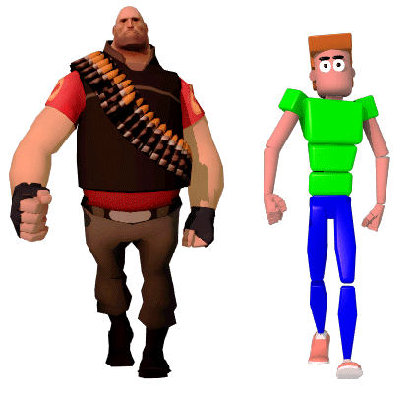
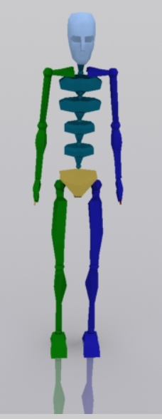
Problem Statement
Adapting a motion from one character to another
The characters are of same form (articulations and structure)
Differs only in proportions and dimensions
Notes:
https://www.ready-motion.com/

Slide 5
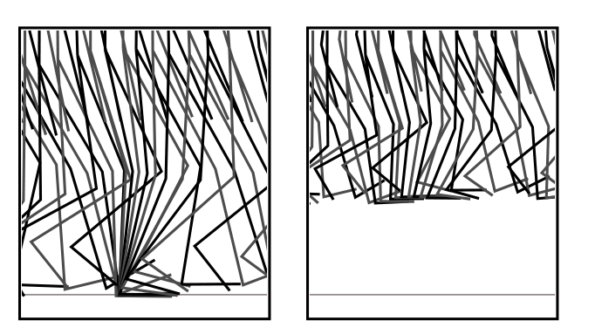
Naïve Approach (INTUITIVE)
Directly transferring data to another skeleton
Possible because all 3D joint angles (except root)
Can cause problems (foot above the ground)

Slide 6
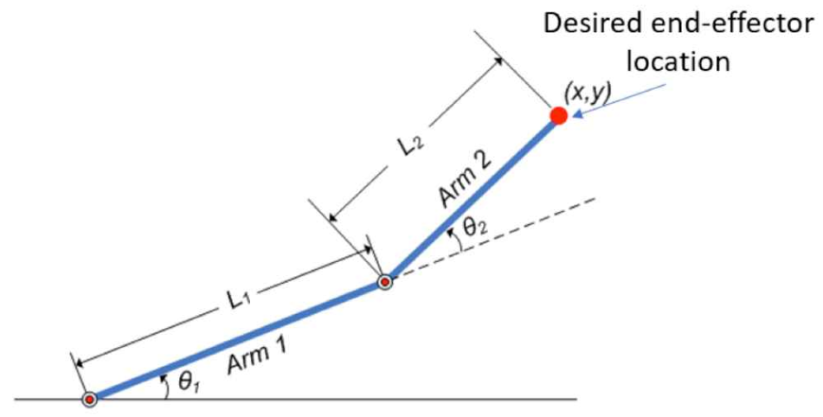
Inverse Kinematics
Skeleton known
Estimate pose (joint angles) based on end effectors’ position
Opposite to forward kinematic chain, hence the name
Notes:
www.mathworks.com

Slide 7
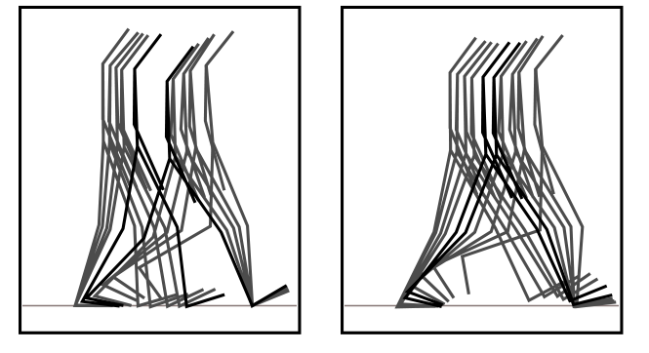
Using Inverse Kinematics
Fix foot constraint so it doesn’t fly off
Each frame treated independently
Causes jerk in motion
Can use low pass filter, still undesirable artifacts

Slide 8
Spacetime problem
Per frame methods cause high freq. motions
Combine all the frames and motion in a single optimization problem
Add constraints for motion

Slide 9
Representation
$qt$ : character configuration in at time t (angles and root)
$m(t)=mo(t)+d(t)$solving for $d(t)$ to get retargeted motion
Constraints : $f(m(t)) <=> constant$
Example : 9 joint angles and root $∈R3$
- $qt$ has 30 dimensions
In a 100 frame data
- $m(t)$ has 3000 dimensions

Slide 10
Constraints
Frame-position : $f(q (ti))<=>constant$
Parameter range: $qi<=>constant$
Two points are a specified distance apart : $f\left(q\left(ti\right)\right)<=>constant$
Point on char. At same position in two different times : $f(q (ti),q (tj))<=>constant$
$qt$ : character configuration in at time t
$m(t)=mo(t)+d(t)$
Constraints : $f(m(t)) <=> constant$

Slide 11
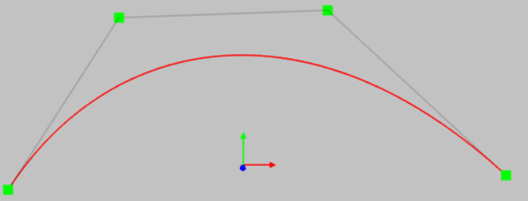
Estimating $d(t)$
Using B splines
Control points after 2,4,6,8 frames
Decided after freq. decomposition
$qt$ : character configuration in at time t
$m(t)=mo(t)+d(t)$
Constraints : $f(m(t)) <=> constant$

Slide 12
Objective Function
Minimize $∫\left(m\left(t\right)−mo\left(t\right)\right)2 , i.e d(t)2$
Be as close to original motion but also satisfying constraints
Another modification : adding weights to parameters
$\left(m\left(t\right)−mo\left(t\right)\right)TM\left(m\left(t\right)−mo\left(t\right)\right)$

Slide 13
The Optimization problem
$$m(t)=mo(t)+d(t)$$
Let $x$ be in set of all control points that calculate $d(t)$
The problem is to find $x$ such that $(d(t))2$is minimum subject to
constraints : $f(m(t)) <=> constant$

Slide 14
The root problem
The root requires scaling ( according to limb size)
Finding a translational shift in motion (in accordance with constraints)

Slide 15
Full Pipeline
Initial Motion
Find the root scaling and motion translation
Find the key spacing for all parameters(2,4,6,8)
Model the constraints
Solve the optimization prob. for $d(t)$
Solve the optimization prob. for 𝑑(𝑡)

Slide 16
Experiments
Walking
112 frames
34 DoF
354 active constraints
< 10 sec computing time

Slide 17
Experiments
Swing dancing
276 frames
1200 active constraints
14 sec computing time

Slide 18
Extension : Motion while morphing
Motion can adapted while the character is changing its proportions
Estimating scaling on each frame

Slide 19
Extension : Retargetting to different structure
Possible when the new character has less DoF
First changing character skeleton to close to the new structure
Manually choosing best matching DoF correspondences

Slide 20
Extension : Relaxing the problem
Previously - $x$ : Minimize $g(x)$ subject to $f(x)=c$
Remove constraints => add a penalty
Now – $x$ : Minimize $g(x) + \left|f\left(x\right)−c \right|$

Slide 21
Limitations
Scalability issues
Lot of manual preprocessing
No evaluation metric

Slide 22
References
http://ai.stanford.edu/~latombe/cs99k/2000/gleicher.pdf (Paper)
www.mathworks.com (slide 6 figure)
https://www.ready-motion.com/ (slide 4 figure)

