Slide 1
Deep Motifs and Motion Signatures
Advisor : Somayeh Hosseini
Authors : Aristidou, Andreas, Daniel Cohen-Or, Jessica K. Hodgins, Yiorgos Chrysanthou, and Ariel Shamir

Slide 2
Motivation
Motion data is not always annotated
Motion clips have large dimensions and can have significant variations in time and space
We need a semantic representation of motion sequences
We want to capture features of motion clips for a better understanding of motion

Slide 3
Related work in motion feature extraction
Motion retrieval :
Systems based on keyword queries provide an intuitive means of query specification
But cannot capture the temporal evolution and dynamics of human motion
Using geometric features of human body parts can extract spatiotemporal information but cannot describe similarity of poses
Angular skeleton representation have difficulty in handling complex motions
Kinematic features based segmentation of motion fails to work on complex motion like dancing and require manual feature selection
The method used in this paper learns the feature space using a deep neural network and represents the motion as a bag of features

Slide 4
What are motion words, motifs and signatures?
Motion words are narrow temporal windows around a given time-frame in the motion sequence
They consist of short sequences of transformation of joints and represent the local evolution of poses
Motion motif correspond to the centroid of a cluster of similar motion words
The distribution of motion motifs represents a motion signature

Slide 5
Examples of motion words

Slide 6
Universal motion words feature space
The challenge is to define an effective feature space R^d
Similar motion words should be positioned closely and dis-similar ones far apart.
Key idea is to use a neural network to map motion words into a latent feature space R^d

Slide 7
Motion Words Definition
Joint rotation angles are used to represent a motion sequence instead of joint positions
This representation is invariant to local translation and local orientation
Each joint defines three rotation values that are in the range of [0, 360] degrees
A motion word is a narrow temporal-window of all joint rotations around a given frame

Slide 8
Defining semantic similarity
Degrees of freedom for human articulation motion is extremely high
Hence defining similarity between motion words is a bit tricky
Two assumptions considered:
Temporally close words are also semantically close
Motion words that are far apart but have similar content in terms of sequence of poses, are also semantically close
Dynamic Time Warping(DTW) is used before measuring similarity for second assumption
DTW is a method that calculates an optimal match between two given sequences by finding matches for every frame in one sequence to every frame in other sequence

Slide 9
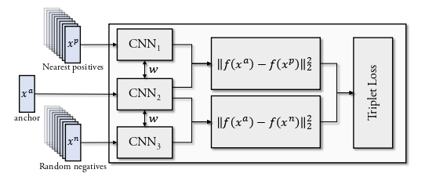
Learning embedding space using Neural network
The network learns a 736x1 embedding using the positive and negative samples.
A triplet loss function is used
Similarity of motion words is measured against positive and negative samples

Slide 10
Loss function
Xa is the anchor word
Xp correspond to positive samples
Xn correspond to negative samples

Slide 11
Choosing positive examples
Two types of positive examples are used
Temporally close words
Words with similar pose sequence
For the first type, 4 words that are temporally closest to xa and without overlap are chosen.
For the second type we take the 5 nearest neighbors by using a time warped distance metric.

Slide 12
where m is the number of joints in the motion word
q i,m , q j,m ∈ S 3 are the complex forms of the quaternion for the m-th joint in the i and j frames

Slide 13
Motion motifs
After mapping motion words to d-dimensional feature space, K-means clustering algorithm is used
Each cluster i, is represented by a motif motion word which is the centroid of the cluster
We assign all motion words to some motif
Given any motion-word, we can associate it to a cluster simply by finding the closest motif using L2 distance in R d

Slide 14
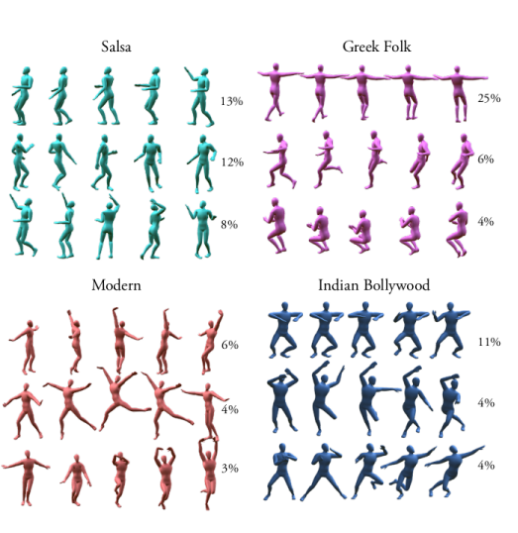
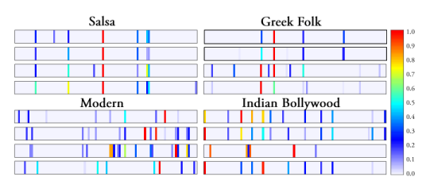
The percentage shown on the right of each motion-motif
indicates the frequency of appearance of that motif cluster in the motion

Slide 15
Motion Signatures
Given a motion sequence S, we first extract all its motion words.
Map them to the universal feature space and assign each word to its representative motif.
We then count the number of words in each of the K clusters and divide by the total number of words in S
This makes the signature invariant to length of motion sequence
Naive frequency counting leads to highly frequent motion words dominating the motion dataset
Hence re-scale motion signatures using tf-idf (term frequency – inverse document frequency

Slide 16
Distance Between Signatures
We use the Earth Mover’s Distance (EMD) to compare signatures as they represent distributions
The Earth Mover's Distance (EMD) between two distributions is proportional to the minimum amount of work required to change one distribution into the other
Assume the motion signatures P and Q that both have m clusters
p i is the motifs quantity (after tf-idf re-weighting) in the i-th cluster of the P signature, and w p i is the corresponding cluster’s dense weight

Slide 17
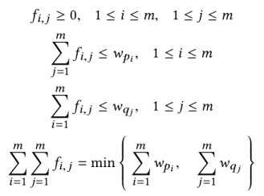
EMD wants to find a flow F = [f (i, j) ], with f (i, j) the flow between pi and qj, that minimizes the overall cost, subjects to the following constraints
The flow refers to the amount of image weight flowing from denser distribution to lighter distribution

Slide 18
Implementation Details
For experiments, 16 most informative joints with their relative joint angles were used
Data used from Carnegie Mellon University motion capture database, the Dance Motion Capture Database of the University of Cyprus and motion data acquired in their own lab
The motion capture data were originally sampled between 120 to 480 fps, but since human motion is locally linear, we reduce it to 24 fps
Different motion word sizes (8, 16, 24, and 48 frames) were used and it was found that using 16 frames was the most efficient

Slide 19
Different values for number of clusters tried and K=100 was found to be a sufficient number for different types of motion
Training the triplet networks took 7 days!!
Approximately 85% of computation time was dedicated to compute the motion words’ pairwise distances using DTW to select positive and negative samples

Slide 20
Datasets used
3 types of datasets were used to train and test the ability of signatures to organize and classify motion sequences
D1 consists of 150 motion clips from 15 different motion classes: walking, running, sitting, jumping, weight-carrying, climbing, swinging, placing ball, placing tee, kicking, soccer and basketball playing, boxing, swimming, salsa and Indian Bollywood dancing
D2 , consists of 30 motion clips of five types of dances: waltz, Latin (salsa, bachata, reggaeton), modern, Indian Bollywood, and Greek folk, with a large deviations in duration, ranging from 20 to 200 seconds
D3 has been selected to evaluate whether motion signatures can capture the fine details of motion, consists of 30 salsa dance sequences, half of them presenting the leader, and half the follower

Slide 21
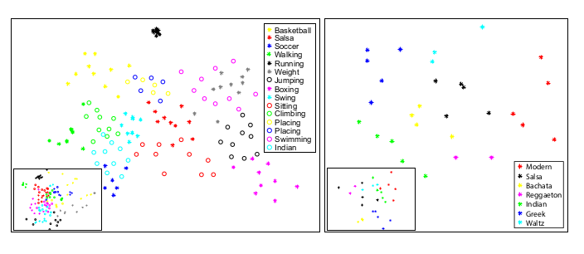
Example of signature classification
Left shows 2D embedding for D1 and D2 for right. The smaller windows correspond to representation using only DTW

Slide 22
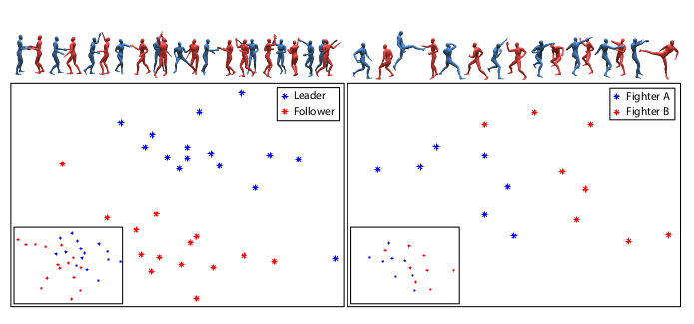
2D embedding for salas dancers and Kung-fu fighters

Slide 23
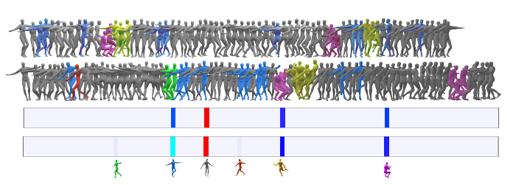
Two sequences of Greek dance. The order and duration of movements is different but the distribution of motifs is similar

Slide 24
Result Comparisons
Performance of clustering using signatures versus other methods. The other methods are based on geometric properties of human motion

Slide 25
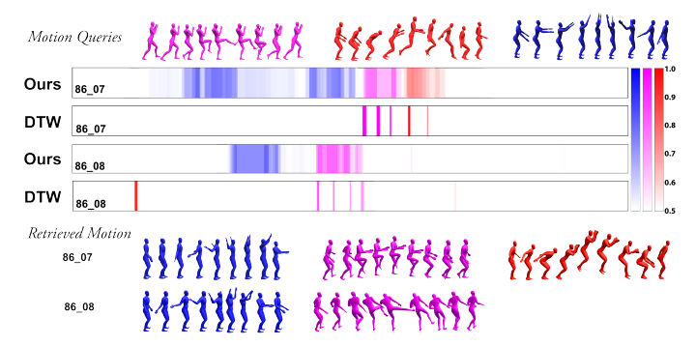
Applications
Query-by-Example Retrieval
Represent the query motion in terms of motion words
Build a signature for it
Scan the sequence in database using a sliding window
Use EMD to measure similarity of retrieved motion

Slide 26
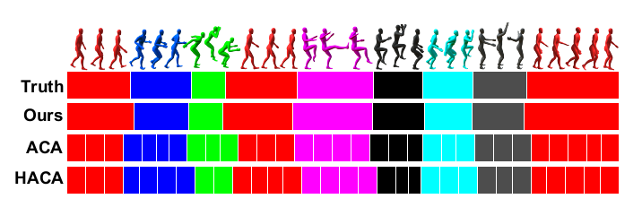
Temporal Segmentation
To divide a motion into distinct motion primitives
Given an input, use a sliding window of 9 motion words and extract the signatures.
The motion word in the middle of the window is assigned to the the motion class (action) that matches the window’s signature using a KNN classifier (with K = 5)

Slide 27
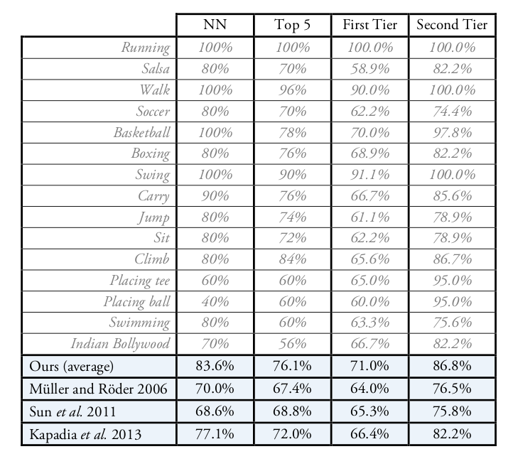
Motion Sequence Retrieval performance. First Tier measures the ratio of correct retrievals in the top K − 1 results (K = 10 in our case) results to the total number of possible correct results (9 in our case). Second Tier measures the ratio of correct retrievals in the top 2(K − 1) results to the total number of possible correct results.

Slide 28
Advantages
Effectively captures semantic representation and establish relation between motion words using an embedding space
The method is able to distinguish fine grained differences in motions
No need of manual labelling of motion words
The Euclidean distance reflects semantic similarity among motion words.
No need of dimensionality reduction
No need to worry about different lengths of motion sequences
Since we just use signature as distribution of motifs, we do not need to worry about temporal differences in sequences

Slide 29
A short video demo by the authors

Slide 30
Limitations and Conclusions
Many human motions are still not represented in the dataset used and can possibly change the metric defined in our universal feature space
Training process is time consuming
An optimized DTW implementation will significantly improve the computational time
Some motion words may be outliers and cannot be correctly assigned to a cluster or motif

Slide 31
References
Aristidou, Andreas, Daniel Cohen-Or, Jessica K. Hodgins, Yiorgos Chrysanthou, and Ariel Shamir. "Deep motifs and motion signatures." In SIGGRAPH Asia 2018 Technical Papers, p. 187. ACM, 2018.
All the images and tables used in the presentation were obtained from the Deep motifs and motion signatures paper
Reference for DTW: https://en.wikipedia.org/wiki/Dynamic_time_warping
Reference for EMD: http://infolab.stanford.edu/pub/cstr/reports/cs/tr/99/1620/CS-TR-99-1620.ch4.pdf

