Slide 1
Interactive character animation by learning multi-objective control
Mirza Misbah Mubeen Baig
2nd May’ 2019

Slide 2
Interactive character animation by learning multi-objective control
Kyungho Lee Seyoung Lee Jehee Lee
Seoul National University
Mirza Misbah Mubeen Baig
2nd May’ 2019

Slide 3
introduction
“Modelling rich connections between a multitude of control objectives and a large repertoire of action”

Slide 4
Road map
Abstract
Structure
Closure

Slide 5
Road map
Abstract
Key Challenges
Previous works
Goals
Structure
Closure

Slide 6
Road map
Abstract
Key Challenges
Previous works
Goals
Structure
Neural Networks
Recurrent Neural Networks
Multi objective control
Inferencing Control objectives
Loss functions
Closure

Slide 7
Road map
Abstract
Key Challenges
Previous works
Goals
Structure
Neural Networks
Recurrent Neural Networks
Multi objective control
Inferencing Control objectives
Loss functions
Closure
Experiments
Discussion
Future Work
Acknowledgements
References

Slide 8
Key Challenges
How to make virtual characters behave like humans ?
How to control virtual characters the way we want ?

Slide 9
Previous works
State Space Search
Mixed Discreet Continuous Optimization

Slide 10
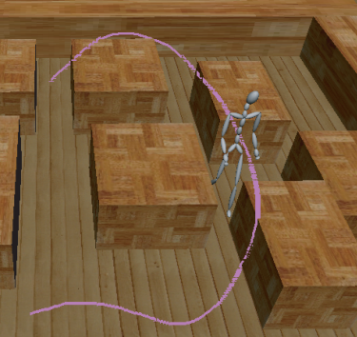
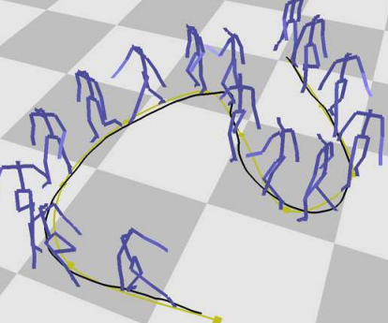
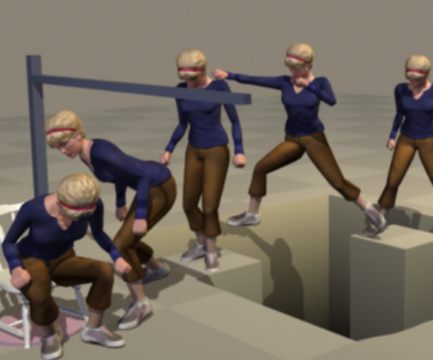
Previous works
State Space Search
Mixed Discreet Continuous Optimization
Lee et al. [2002]
Kovar et al. [2002]
Safonova and Hodgins. [2007]

Slide 11
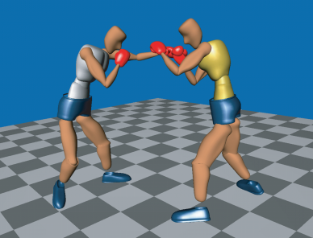
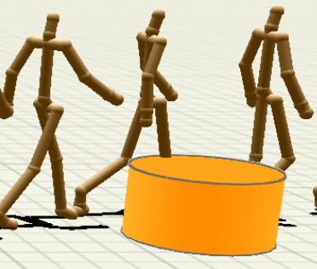
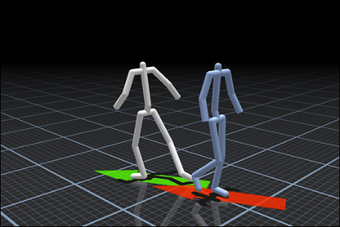
Previous works
State Space Search
Mixed Discreet Continuous Optimization
Kim et al. [2012]
Won et al. [2014]
Hyun et al. [2016]

Slide 12
Previous works
State Space Search
Mixed Discreet Continuous Optimization
“Both the approaches are computationally demanding and cannot achieve interactive performance”

Slide 13
Goals
“How one controller helps in learning multiple actions”

Slide 14
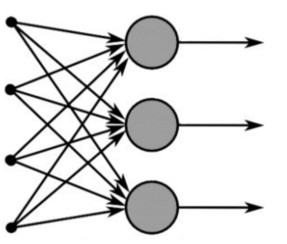
Basic Concepts
Neural Networks

Slide 15
Basic Concepts
Neural Networks

Slide 16
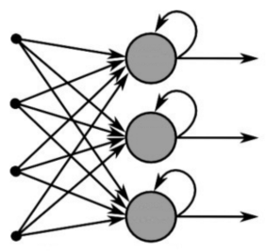
Basic Concepts
Recurrent Neural Networks

Slide 17
Basic Concepts
Recurrent Neural Networks

Slide 18
Basic Concepts
Long Short-Term Memory (LSTM)
Image source: Google

Slide 19
Structure
Network
Control Parameter
Predicted Parameter
Current Motion
Next Motion

Slide 20
Structure
Encoder
Decoder
LSTM 1
LSTM 2
LSTM 3
LSTM 4
Control Parameter
Predicted Parameter
Current Motion
Next Motion

Slide 21
Structure
$G_{t}=diag\left(S\right). F_{t}+diag\left(1−S\right).P_{t}$
$$G_{t}:Control Parameter$$
$$P_{t}:Predicted Parammter$$
$$m_{t}:Current motion$$
$$m_{t+1}:Next motion$$
Encoder
Decoder
LSTM 1
LSTM 2
LSTM 3
LSTM 4
Control Parameter
Predicted Parameter
Current Motion
Next Motion

Slide 22
Structure
$G_{t}=diag\left(S\right). F_{t}+diag\left(1−S\right).P_{t}$
$$G_{t}:Control Parameter$$
$$P_{t}:Predicted Parammter$$
$$m_{t}:Current motion$$
$$m_{t+1}:Next motion$$
Encoder
Decoder
LSTM 1
LSTM 2
LSTM 3
LSTM 4
Control Parameter
Predicted Parameter
Current Motion
Next Motion

Slide 23
Multi-Objective Control
Combining control parameter of each action as one unified form,
$$F= \bigcup_{a}{fa}$$

Slide 24
Multi-Objective Control
Combining control parameter of each action as one unified form,
$$F= \bigcup_{a}{fa}$$
$$F=f_{dribble}∪f_{shoot}=(position, direction)$$

Slide 25
Multi-Objective Control
Combining control parameter of each action as one unified form,
$$F= \bigcup_{a}{fa}$$
$$F=f_{dribble}∪f_{shoot}=(position, direction)$$
What value should we put in a parameter that is irrelevant to the action?

Slide 26
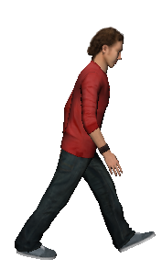
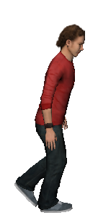
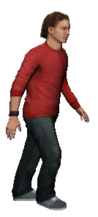
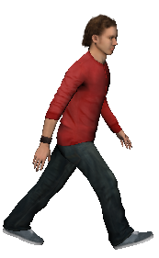
Inferencing Control Objective
$$m_{t+k}$$
$$m_{t}$$
$$m_{t+1}$$
$$m_{t+2}$$
Image source: Presenter’s slide

Slide 27
(1) Loss Function
$$E= E_{motion}+ E_{contact}+ E_{Rigid}$$

Slide 28
(1) Loss Function
$$E= E_{motion}+ E_{contact}+ E_{Rigid}$$
Where,
$E_{motion}\text{= }\sum_{t}{{\text{∥}\text{mt}\text{ − }\text{m}\text{′ }\text{t}\text{ ∥ }}^{2} }$
$E_{contact}=\sum_{t}{\sum_{k}{c_{t}^{k}}}c_{t+1}^{k}$ ${\text{∥}h_{t}^{k}−T(h_{t+1}^{k}) \text{∥}}^{2}$
$E_{rigid}=\sum_{t}{\sum_{(k,m)}{({\text{∥}h_{t}^{k}−h_{t}^{m}\text{∥}\text{− }l_{km}\text{ )}}^{2}}}$

Slide 29
(2) Loss Function
Ball trajectory
$$E_{ball}= E_{hand}+ E_{bounce}$$

Slide 30
(2) Loss Function
Ball trajectory
$$E_{ball}= E_{hand}+ E_{bounce}$$
Where,
$E_{hand}=\sum_{t}{\sum_{k}{c_{t}^{k}}}$ ${\text{∥}{ |h}_{t}^{k}−b_{t}^{}| −radius \text{∥}}^{2}$
$E_{bounce}= \sum_{t}{\left(1−c_{t}\right)c_{t+1} {|\left|y_{t}−radius\right||}^{2}}$

Slide 31
(2) Loss Function
Ball trajectory
$$E_{ball}= E_{hand}+ E_{bounce}$$
Where,
$E_{hand}=\sum_{t}{\sum_{k}{c_{t}^{k}}}$ ${\text{∥}{ |h}_{t}^{k}−b_{t}^{}| −radius \text{∥}}^{2}$
$E_{bounce}= \sum_{t}{\left(1−c_{t}\right)c_{t+1} {|\left|y_{t}−radius\right||}^{2}}$
$y_{t+1}=c_{t}b_{t+1}^{y}+\left(1−c_{t+1}\right)min⁡(y_{t}, b_{t+1}^{y})$

Slide 32
(2) Loss Function
Ball trajectory
(result of adding the ball trajectory terms)
Video source: Presenter’s slide
Video source: Presenter’s slide

Slide 33
(1) Experiments
Algorithm is implemented in Python using tensor flow
Activation Function
tanh
Optimization Algorithm
Adam
RNN with 4 LSTM layers
Each layer of size 512

Slide 34
(2) Experiments
Data Sets
Locomotion
Basket ball
Tactics Board
Tennis
Data Augmentation
Teacher Forcing

Slide 35
Discussion
This model is learning controllers exploiting readily available databases .
Neural networks is converting control algorithms to controllers.
Recently explored approaches such as physics-based and data-driven animation method can be used to learning the deep neural networks

Slide 36
Future Work
“simulation and control of multiple characters physically interacting with each other at close distance”

Slide 37
Acknowledgements
This research was supported by the MSIP (Korea), under the SW STARLab support program supervised by the IITP

Slide 38
References
Daniel Holden, Taku Komura, and Jun Saito. 2017. Phase-functioned neural networks for character control. ACM Transactions on Graphics 36, 4, Article 42 (2017).
Felix A Gers and E Schmidhuber. 2001. LSTM recurrent networks learn simple contextfree and context-sensitive languages. IEEE Transactions on Neural Networks 12, 6 (2001), 1333–1340.
Alex Graves and Navdeep Jaitly. 2014. Towards end-to-end speech recognition with recurrent neural networks. In the 31st International Conference on Machine Learning. 1764–1772
Daniel Holden, Jun Saito, and Taku Komura. 2016. A deep learning framework for character motion synthesis and editing. ACM Transactions on Graphics 35, 4, Article 138 (2016).
Myung Geol Choi, Manmyung Kim, Kyung Lyul Hyun, and Jehee Lee. 2011. Deformable Motion: Squeezing into cluttered environments. Computer Graphics Forum 30, 2 (2011), 445–453
Partha Ghosh, Jie Song, Emre Aksan, and Otmar Hilliges. 2017. Learning Human Motion Models for Long-term Predictions. arXiv preprint arXiv:1704.02827 (2017).

Slide 39
Thank you!!
Open for Discussion . . .

Slide 40
Extra

